Slide 1
EXCEL FINAL PROJECT
TEAM MEMBERS
Lara Jarnagin
Arzu Rahimli
Muksana Khatun
Alice Sabeti

Slide 2
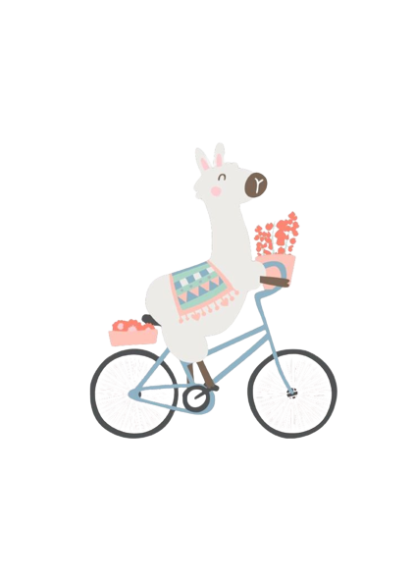
Sales Analysis
LAMA BIKE

Slide 3

LAMA BIKE
Created: 2010
Business sector: Bike sales
Total revenue: 17713385 (2016)
Products: Accessories, Bike, Clothing
Market: Canada, US, Europe

Slide 4

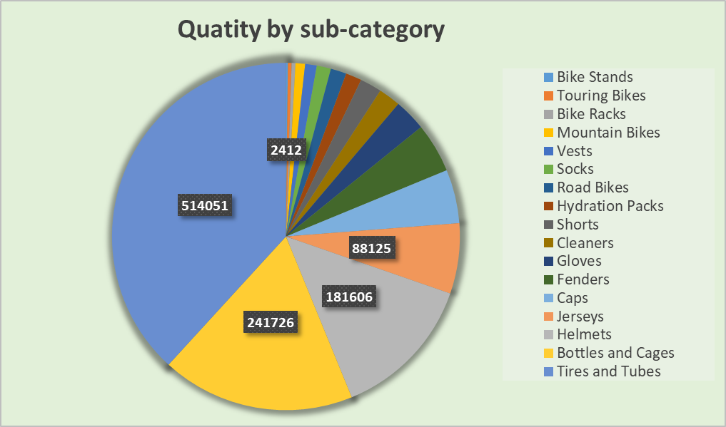
Sales performance of sub-category by quantity
The greatest number of units
The least number of units sold
Criteria | Sub-category | Quantity
The greatest number | Tires and Tubes | 514,051
The least number | Bike stands | 2,412

Slide 5
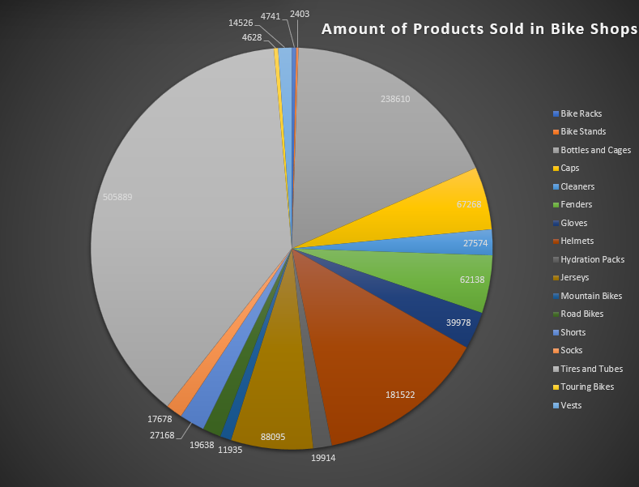

Slide 6
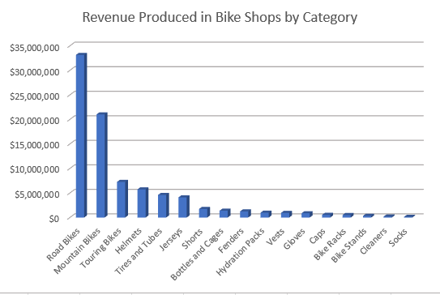
Revenue performance by sub-category
The greatest amount of revenue generated
The least amount of revenue generated
Criteria | Sub-category | Amount
The greatest amount | Road bikes | $33,150,708
The least amount | Socks | $147,171

Slide 7
For the sub-category above, which product had:
The least number of units sold
The least amount of revenue generated
Criteria | Product category | Quantity
The greatest amount ordered | Water bottle-30 oz | 162,051
The least amount ordered | Mountain-500 Black, 2 | 40
Criteria | Product category | Amount
The greatest amount | Road-150 Red, 62 | $3,810,023
The least amount | Mountain -500 Black, 52 | $19,287

Slide 8
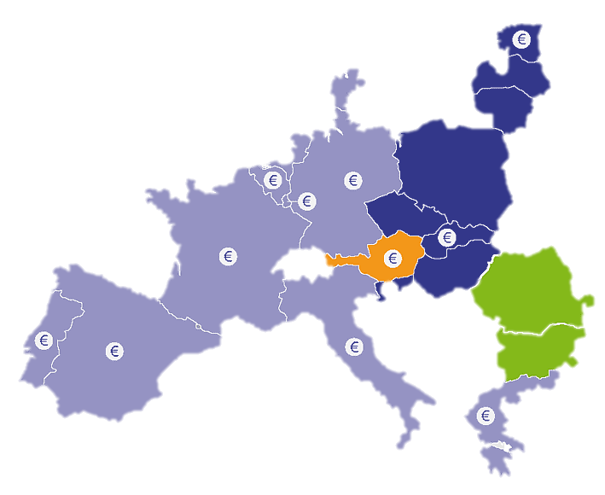
EUROPEAN MARKET ANALYSIS

Slide 9
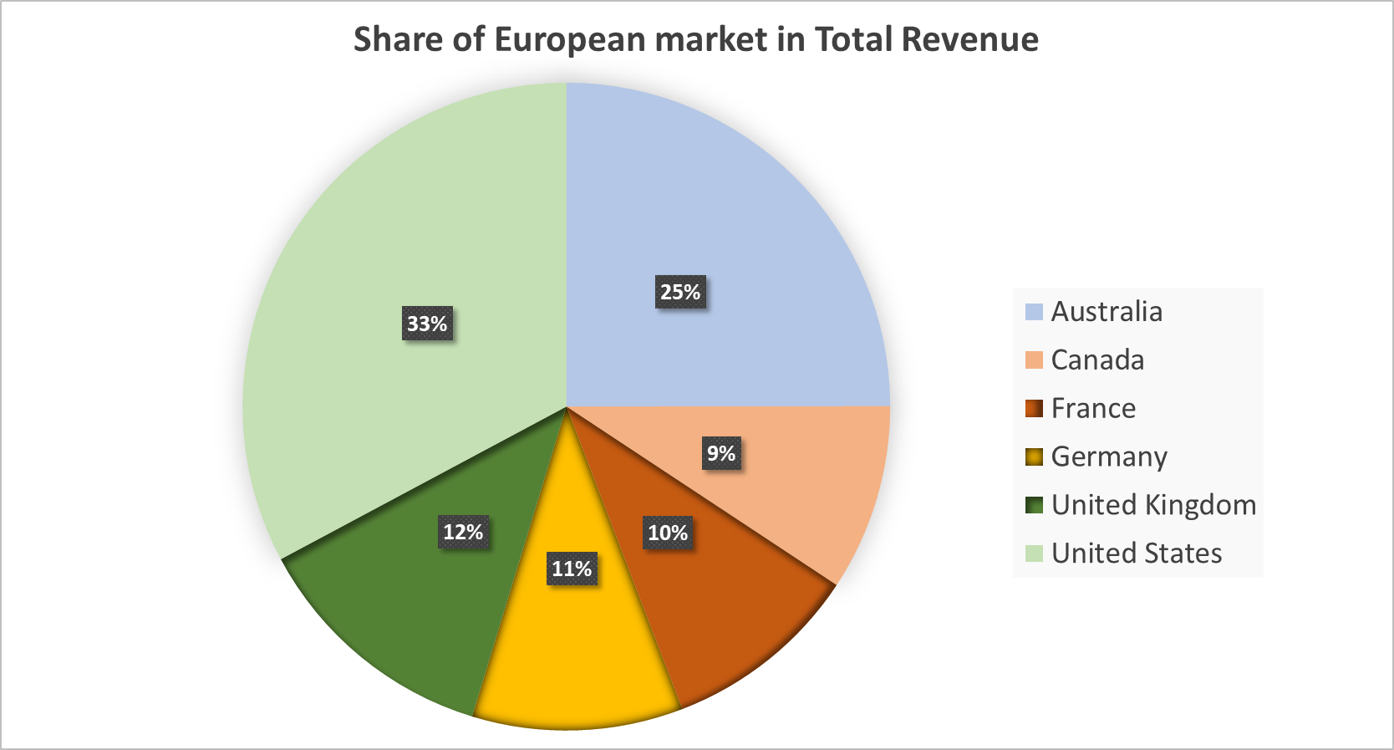
Share of European market in total revenue is approximately 33%

Slide 10
Which day did Europe had the:
Greatest amount of revenue generated
Greatest amount of units sold

Slide 11
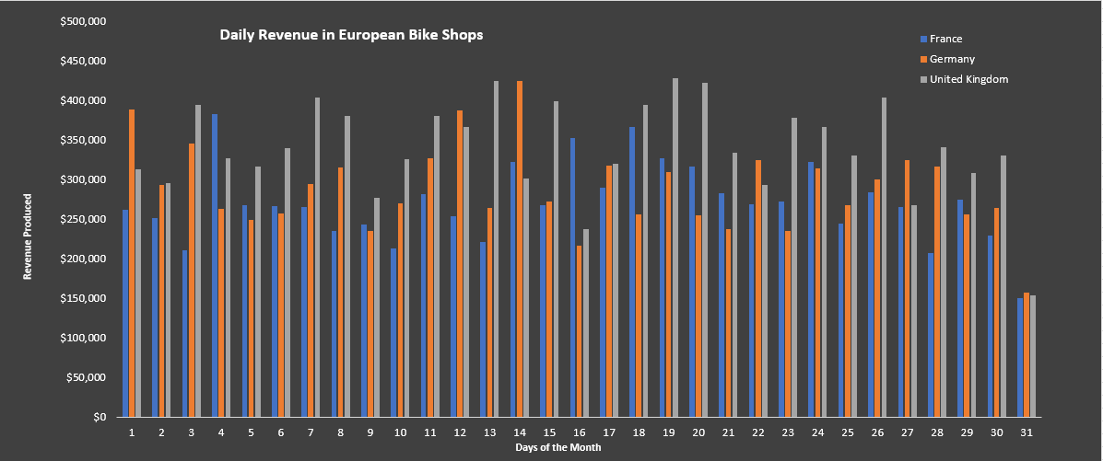
Which day did Europe had the:
Greatest amount of revenue generated
The 19th had the greatest amount of revenue generated = $1,067,212.00 for France, Germany and the UK, and the 31st was the least amount of revenue = $462,456.00 for France, Germany and the UK

Slide 12
The 19th had the greatest amount of revenue generated = $1,067,212.00 for France, Germany and the UK
The 31st was the least amount of revenue = $462,456.00 for France, Germany and the UK

Slide 13
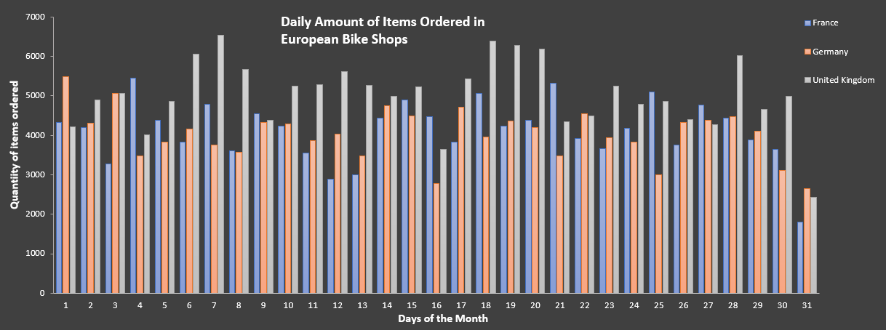
Which day did Europe had the: Greatest amount of units sold was on the 18th of each month at 15407, and the least amount of units sold was on the 31st at 6864

Slide 14
Greatest amount of units sold was on the 18th of each month at 15407
The least amount of units sold was on the 31st at 6864

Slide 15
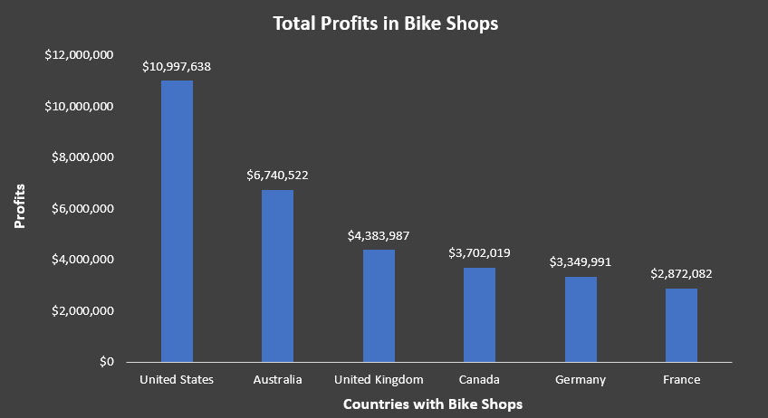
The U.S. had the most profits for bike sales likely due to population differences

Slide 16
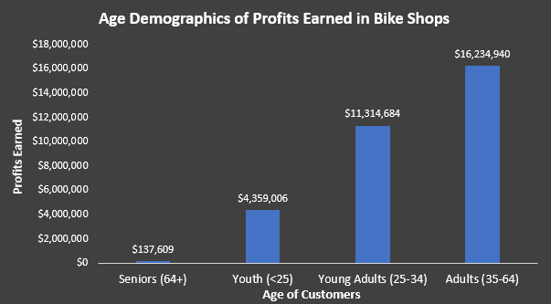
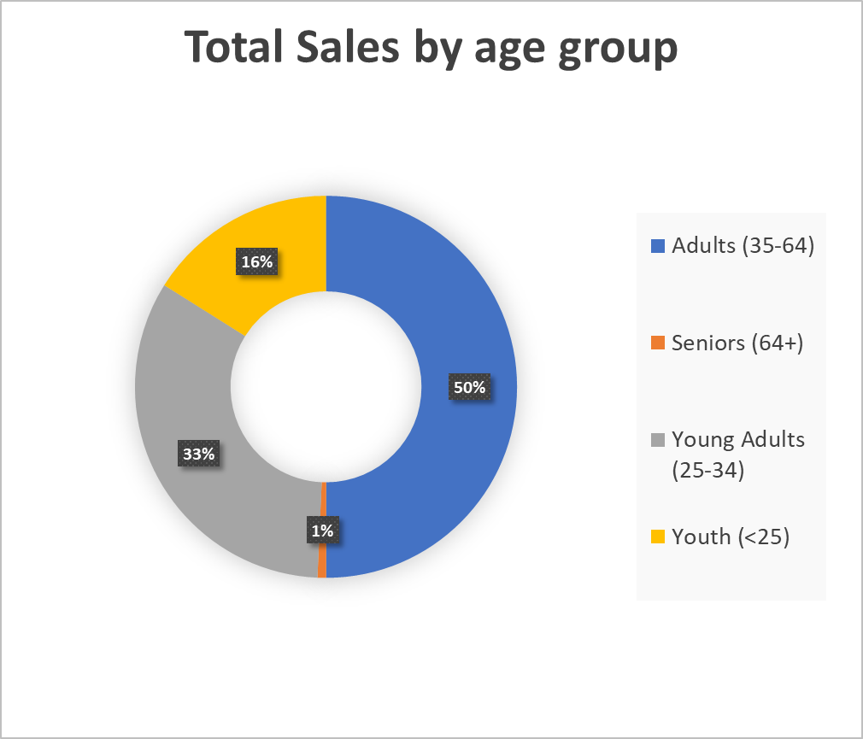
Adults (35-64) were the largest group of individuals making purchases at bike stores

Slide 17
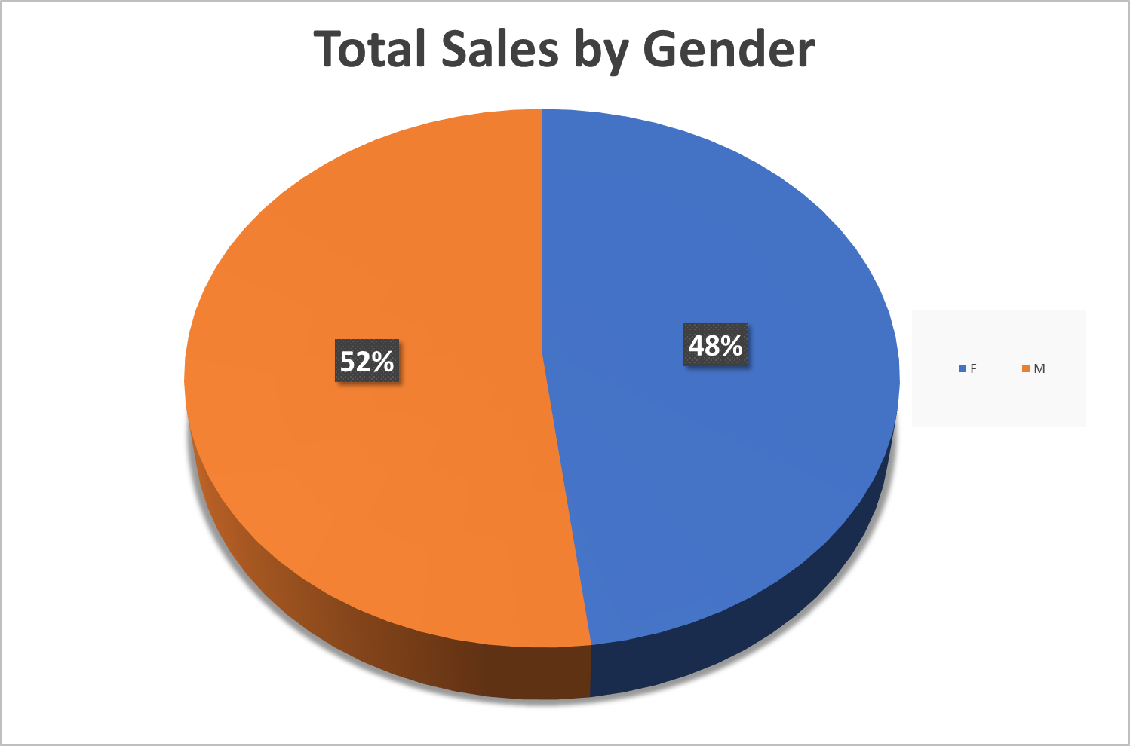

Slide 18
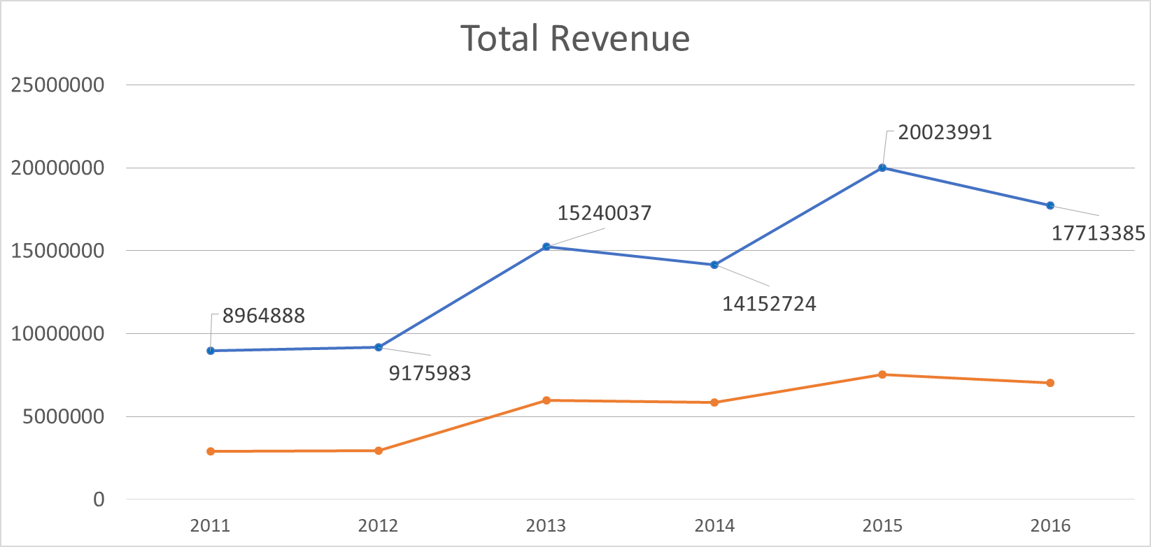

Slide 19
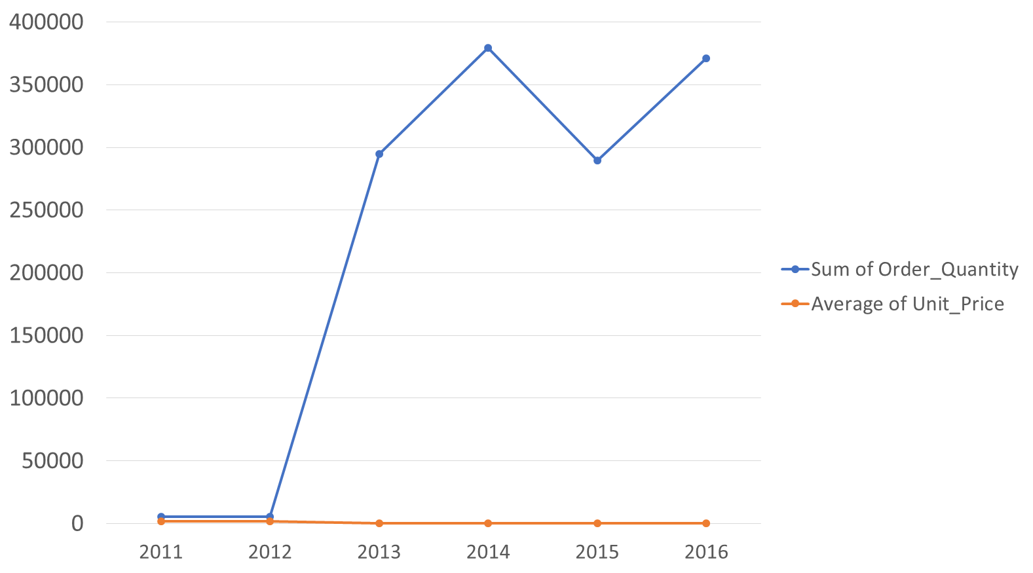
Change in revenue over the time is the result of change in the quantity

Slide 20
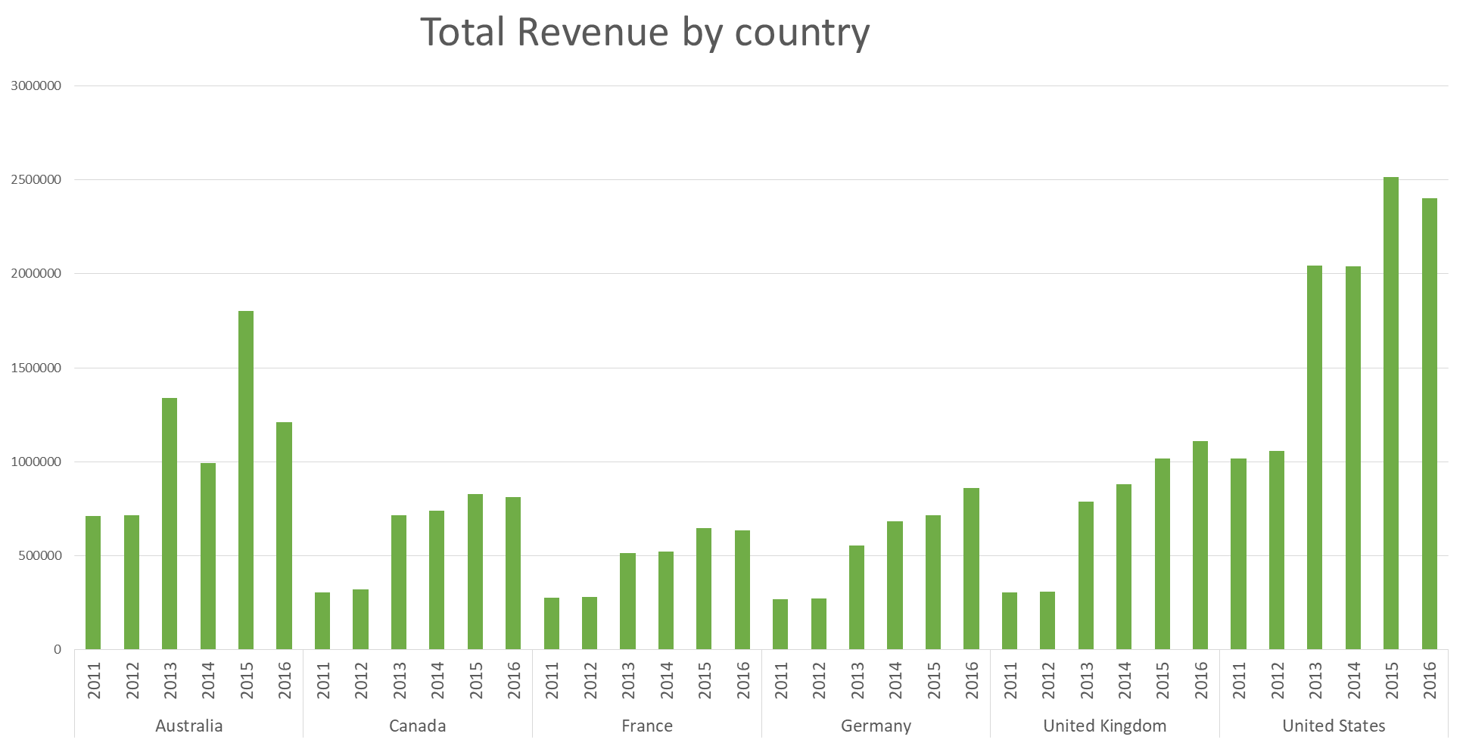

Slide 21
